Slide 1
Lehninger of Principles of Biochemistry
David L. Nelson and Michael M. Cox
6th edition

Slide 2
Amino Acids
Amino acids are building blocks of proteins.
Proteins are composed of 20 different amino acid (encoded by standard genetic code, construct proteins in all species ).
Their molecules containing both amino and carboxyl groups attached to the same a-carbon (L-a-amino acids).
Their chemical structure influences three dimensional structure of proteins.
They are important intermediates in metabolism (porphyrins, purines, pyrimidines, creatin, urea etc).
They can have catalytic function.
Several genetic disorders are cause in amino acid metabolism (aminoaciduria - presence of amino acids in urine)

Slide 3
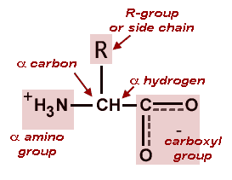
The basic structure of amino acids differ only in the structure or the side chain (R-group).
L-isomer
L-isomer is normally found in proteins.

Slide 4
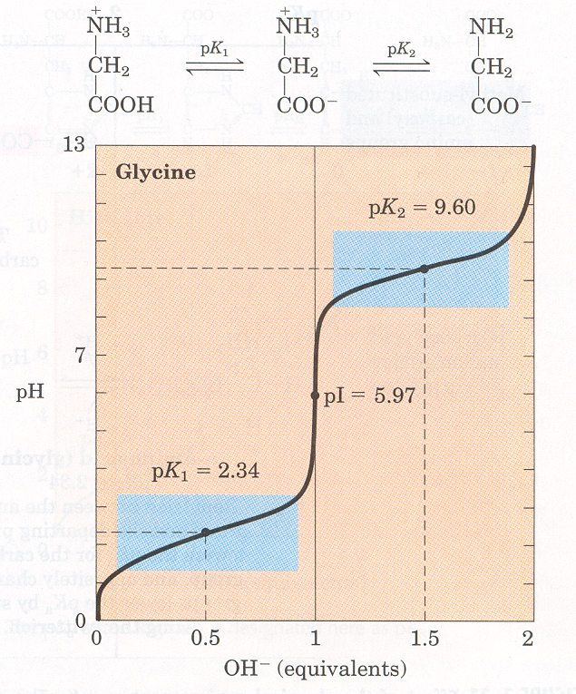



Amino acids and their titration curves
Proton donor
Proton acceptor
At the midpoint – pK=9.60 there is equimolar concentration of proton donor and proton acceptor.
+
Dipolar ion
Isoelectric point
+
At the midpoint – pK1=2.34 there is equimolar concentration of proton donor and proton acceptor.
The isoelectric point (pI, pH(I), IEP), is the pH at which a particular molecule carries no net electrical charge. The standard nomenclature to represent the isoelectric point is pH(I)
Proton donor
Proton acceptor
Fully protonated form at very low pH

Slide 5
Henderson/Hasselbach equation and pK_{a}
Protonated form
Unprotonated form (conjugate base)
HA
H⁺
+
A⁻
[H⁺]
[A⁻]
K_{a}
=
[HA]
[HA]
[H⁺]
=
K_{a}
x
[A⁻]
[HA]
-log
[H⁺]
=
-log
K_{a}
-log
[A⁻]
[A⁻]
pH
=
pK_{a}
+
log
[HA]

Slide 6
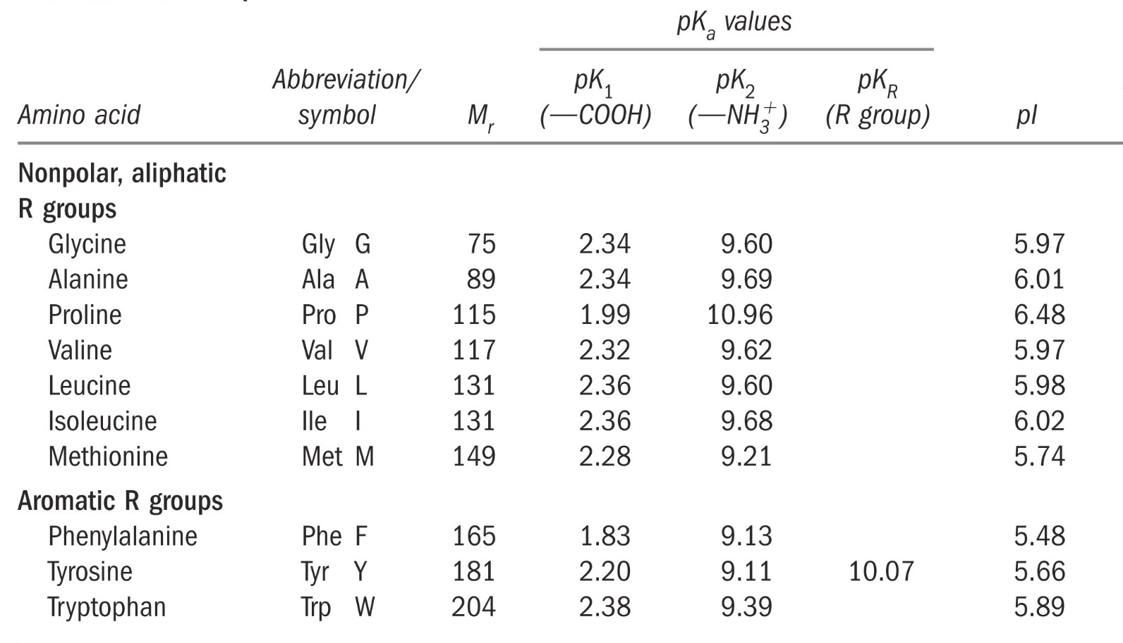
Properties and Conventions Associated with the common amino acid found in proteins

Slide 7
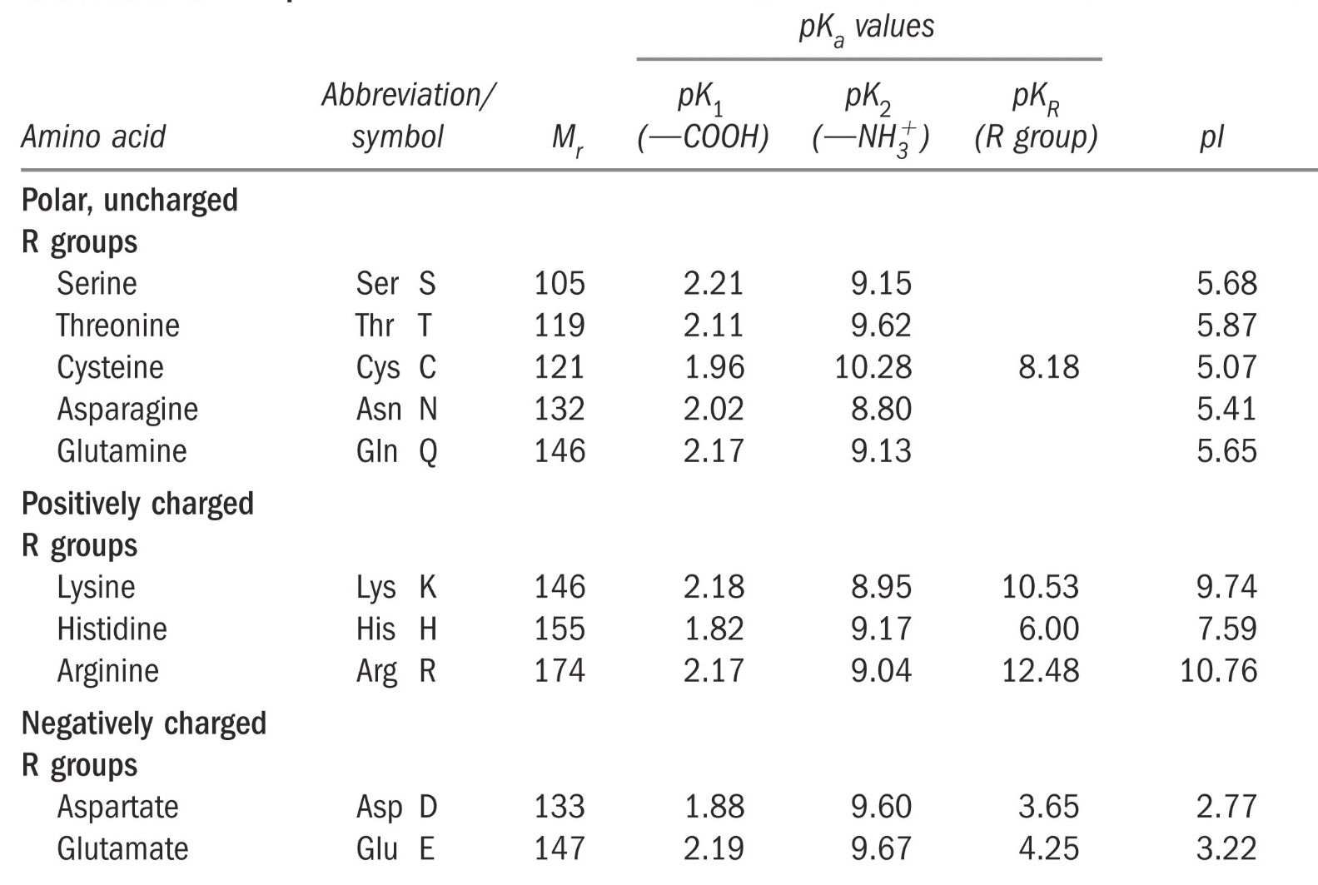
Properties and Conventions Associated with the common amino acid found in proteins

Slide 8
Classification of Amino Acids
Amino acids are generally divided into groups on the basis of their side chains (R groups).
The most helpful start-point is to separate amino acids into:
Nonpolar
Neutral polar
Charged polar
1. Nonpolar amino acids
Only carbon and hydrogen in their side chains.
Generally unreactive but hydrophobic.
Determining the 3-D structure of proteins (they tend to cluster on the inside of the molecule).

Slide 9









Nonpolar (Hydrophobic) R Groups
Glycine (Gly)
Alanine (Ala)
Valine (Val)
Leucine (Leu)
Isoleucine (Ile)
Methionine (Met)
Phenylalanine (Phe)
Proline (Pro)
Tryptophan (Trp)
http://www.indstate.edu/thcme/mwking/amino-acids.html

Slide 10
The simplest amino acid is Glycine, which has a single hydrogen atom as its side chain.
Alanine, Valine, Leucine and Isoleucine have saturated hydrocarbon R groups (i.e. they only have hydrogen and carbon linked by single covalent bonds). Leucine and Isoleucine are isomers of each other.
Alanine
Valine
Leucine
Isoleucine

Slide 11
The side chain of Methionine includes a sulfur atom but remains hydrophobic in nature.
Phenylalanine is Alanine with an extra benzene (sometimes called a Phenyl) group on the end. Phenylalanine is highly hydrophobic and is found buried within globular proteins.
Methionine
Phenylalanine

Slide 12
Tryptophan is highly hydrophobic and tends to be found immersed inside globular proteins.
Structurally related to Alanine, but with a two ring (bicyclic) indole group added in place of the single aromatic ring found in Phenylalanine.
The presence of the nitrogen group makes Tryptophan a little less hydrophobic than Phenylalanine.

Slide 13
Proline is unique amongst the amino acids – its side chain is bonded to the backbone nitrogen as well as to the α-carbon.
Because of this proline is technically an imino rather than an amino acid.
The ring is not reactive, but it does restrict the geometry of the backbone chain in any protein where it is present.

Slide 14






Polar (Hydrophilic) R Groups
Serine (Ser)
Cysteine (cys)
Threonine (Thr)
Asparagine (Asn)
Glutamine (Gln)
Tyrosine (Tyr)
http://www.indstate.edu/thcme/mwking/amino-acids.html

Slide 15
Tyrosine is Phenylalanine with an extra hydroxyl (-OH) group attached.
It is polar and very weakly acidic. Tyrosine can play an important catalytic role in the active site of some enzymes. Reversible phosphorylation of –OH group in some enzymes is important in the regulation of metabolic pathways
Serine and Threonine play important role in enzymes which regulate phosphorylation and energy metabolism.

Slide 16
Cysteine has sulphur-containing side group.The group has the potential to be more reactive.It is not very polar.
Cysteine is most important for its ability to link to another cysteine via the sulphur atoms to form a covalent disulfide bridge, important in the formation and maintenance of the tertiary (folded) structure in many proteins.
-
-
-
-
-
-
COOH
CH
CH₂
HS
SH
CH₂
CH
COOH
NH₂
NH₂
S
S

Slide 17
Asparagine and Glutamine are the amide derivatives of Aspartate (Aspartic acid) and Glutamate (Glutamic acid) - see below. They cannot be ionised and are therefore uncharged.
Asparagine
Glutamine

Slide 18


Negatively (Nonpolar) Charged R Groups
Aspartic acid (Asp)
Glutamic acid (Glu)
Two amino acids with negatively charged (i.e. acidic) side chains - Aspartate (Aspartic acid) and Glutamate (Glutamic acid).
These amino acids confer a negative charge on the proteins of which they are part.

Slide 19



Positively Charged R Groups
Lysine (Lys) Arginine (Arg) Histidine (His)
Lysine and Arginine both have pKs around 10.0 and are therefore always positively charged at neutral pH.
With a pK of 6.5, Histidine can be uncharged or positively charged depending upon its local environment.
Histidine has an important role in the catalytic mechanism of enzymes and explains why it is often found in the active site.

Slide 20
Classification Based on Chemical Constitution
Small amino acids – Glycine, Alanine
Branched amino acids – Valine, Leucine, Isoleucine
Hydroxy amino acids (-OH group) – Serine, Threonine
Sulfur amino acids – Cysteine, Methionine
Aromatic amino acids – Phenylalanine, Tyrosine, Tryptophan
Acidic amino acids and their derivatives – Aspartate, Asparagine, Glutamate, Glutamine
Basic amino acids – Lysine, Arginine, Histidine
Imino acid - Proline

Slide 21
Essential Amino Acids in Humans
Required in diet
Humans incapable of forming requisite
carbon skeleton
Arginine*
Histidine*
Isoleucine
Leucine
Valine
Lysine
Methionine
Threonine
Phenylalanine
Tryptophan
* Essential in children, not in adults

Slide 22
Non-Essential Amino Acids in Humans
Not required in diet
Can be formed from keto acids by transamination and subsequent reactions
Alanine
Asparagine
Aspartate
Glutamate
Glutamine
Glycine
Proline
Serine
Cysteine (from Met*)
Tyrosine (from Phe*)
* Essential amino acids

Slide 23

Many things in nature look similar, but they are completely different (Isomers)
Chirality
Net source

Slide 24
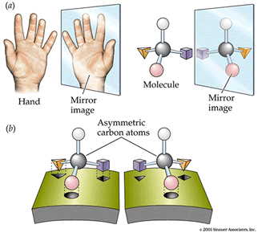
The Stereochemistry of Amino Acids
Chiral molecules existing in two forms
http://www.imb-jena.de/~rake/Bioinformatics_WEB/gifs/amino_acids_chiral.gif

Slide 25
1-Classification according to the structure of the side chain R.
a)Aliphatic amino acids ; They are amino acids with aliphatic groups in their side chains .
b)Aromatic amino acids; They are amino acids with aromatic groups in their side chains (contain a phenyl group).
2-Classification according to the polarity of the side chain R.
a) Polar amino acids ;
1-Polar uncharged amino acids .
2-Polar charged amino acids which can be;
3-Polar acidic or positively charged amino acids.
4-Polar basic or negatively charged amino acids.
b) Non-polar amino acids.
3- Classification based on their nutritional value.
4-Classification based on their metabolic fate.

Slide 26
Amino Acids Application
The non-polar side chain cannot ionize and cannot form Hydrogen bonds. These side chains are have a hydrophobic nature thus they are participate in hydrophobic interactions. Non-polar amino acids cluster and are usually buried in the interior of the protein molecule far from the aqueous polar environment.
The polar side chain can form Hydrogen bonds and charged polar side chains can form ionic bonds . Due to their polar hydrophilic nature they are usually located at the exterior of the protein molecule in contact with aqueous polar environment.

Slide 27
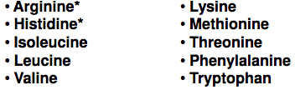
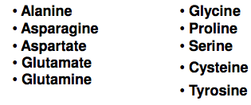
Further classification of amino acids based on their nutritional value
1-Essential amino acids ; They are those amino acids that cannot be synthesized in the body thus they are essential in the diet.
Essential amino acids include the following amino acids ;
2- Non-essential amino acids; They are those amino acids that can be synthesized in the body thus they are non-essential in the diet.

Slide 28
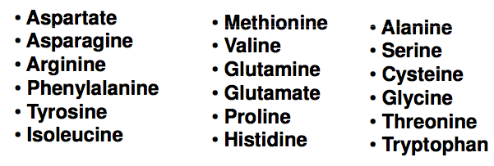
Classification based on their metabolic fate
1-Glucogenic amino acids ;They are amino acids that can be used for glucose synthesis .

Slide 29
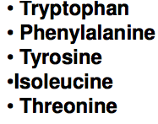
Classification based on their metabolic fate
2-Ketogenic amino acids ; They are those amino acids that can be used for ketone body synthesis only.
Lys and Leuc.
3-Ketogenic and glucogenic amino acids ; They are those amino acids that can be used both for ketone body synthesis,and glucose synthesis.

